Slide 1


Smart Helmet: Revolutionizing Rider Safety with IoT
Innovative Technology for Safer Roads
by Ajay Balami
1

Slide 2
Table Of Contents
Introduction
Problem Statement
Objectives
Feature
Components Used
Working Mechanism
Conclusion
2

Slide 3
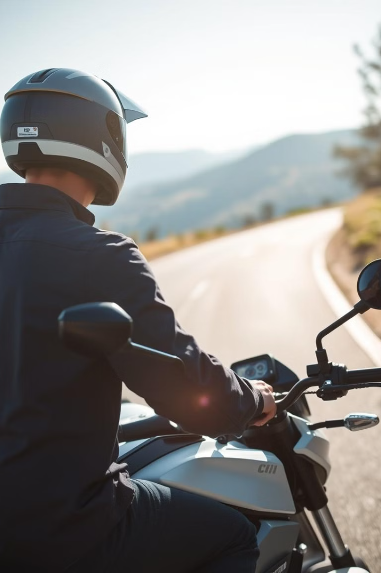
Introduction
The Smart Helmet is a revolutionary solution designed to enhance rider safety and convenience using IoT technology.“
It is an intelligent, multi-functional helmet that challenges faced by riders.
Goal is to integrate advanced safety features into a helmet to prevent accidents, encourage safe riding behaviors, and enable rapid emergency response
3
Notes:
"Every year, millions of lives are affected by road accidents. According to the World Health Organization, over 1.3 million people lose their lives in road traffic crashes annually, and a significant percentage of these involve two-wheelers.“
Studies reveal that wearing helmets can reduce the risk of head injuries by up to 70%. Yet, many riders neglect this essential safety measure, leading to preventable fatalities. Drunk driving, overspeeding, and delayed medical assistance further exacerbate the situation."
"What if technology could make riding safer and smarter? Introducing the Smart Helmet—a revolutionary solution designed to address these challenges and prioritize rider safety."

Slide 4
Problem Statement
Inconsistent Helmet Usage
Drunk Driving
Other Risks
Many riders do not wear helmets consistently, leading to serious injuries in accidents.
Impaired driving is a major contributor to motorcycle accidents, resulting in fatalities and injuries.
Over speeding, reckless driving, and delayed emergency response contribute to the problem.
4
Notes:
Inconsistent helmet usage
Drunk driving
Over speeding
Reckless driving
Delayed emergency response

Slide 5
Objective
1
Enhanced Rider Safety
2
Reduced Accidents
Our goal is to enhance rider safety by using advanced IoT technology.
We aim to reduce accidents caused by helmet non-usage and other preventable factors.
3
Improved Emergency Response
The Smart Helmet will provide real-time alerts and location data for faster emergency response.
5
Notes:
Develop an IOT solution integrating helmet detection, alcohol detection, obstacle detection and reckless driving monitoring to enhance motorcycle rider safety.
Reduce motorcycle-related accidents and fatalities, particularly in high-risk regions like Nepal, by enforcing safety measures
Implement a scalable and reliable system to ensure consistent performance under diverse conditions.
Promote safer riding practices and contribute to global road safety initiatives through technological innovation.
iv. Address delayed emergency response by integrating SOS functionality to notify emergency contacts with location-based alerts, ensuring timely medical intervention.

Slide 6
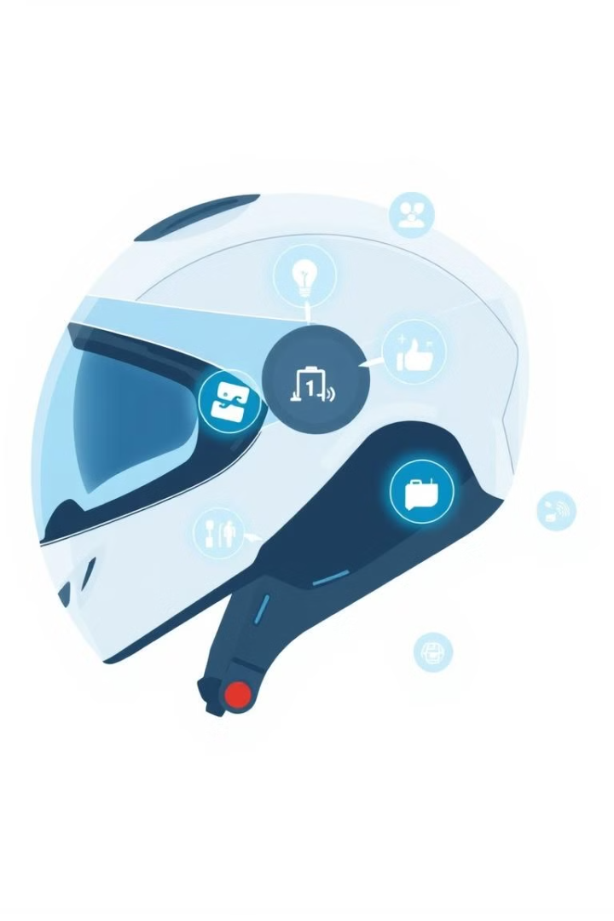





Features Overview
Helmet Detection
Alcohol Monitoring
Ensures the rider is wearing the helmet properly.
Detects alcohol levels and prevents drunk driving.
Driving Monitoring
SOS Emergency Service
Incline Angle, Speed, Engine Temperature, Obstacle Detect
Allows the user to share their location once they press SOS button
6
Notes:
Mobile App Integration

Slide 7
5.9 days
5.3 days
11 days
6 days
2 days
Today
2025
Project Timeline
Analysis, Research
Concept Development
Preparation
100%
May 27 – Jun 5
Requirements
100 %
June 10 – June 25
Logic Designing
100%
June 15- Aug 5
Circuit Prototyping
June 20-Ooct -2
9
Development
Sept-15- Dec-25
Testing
Nov 5 – Jan 5
2024
Implementation
Jan 9
May
June
July
Aug
Sept
Oct
Nov
Dec
Jan
Feb
Months
2025
Jan 19
May 20
Project Hand-Off
Project Proposal Approval
Fig: Work Flow of Project
7
Notes:
77 modular development

Slide 8
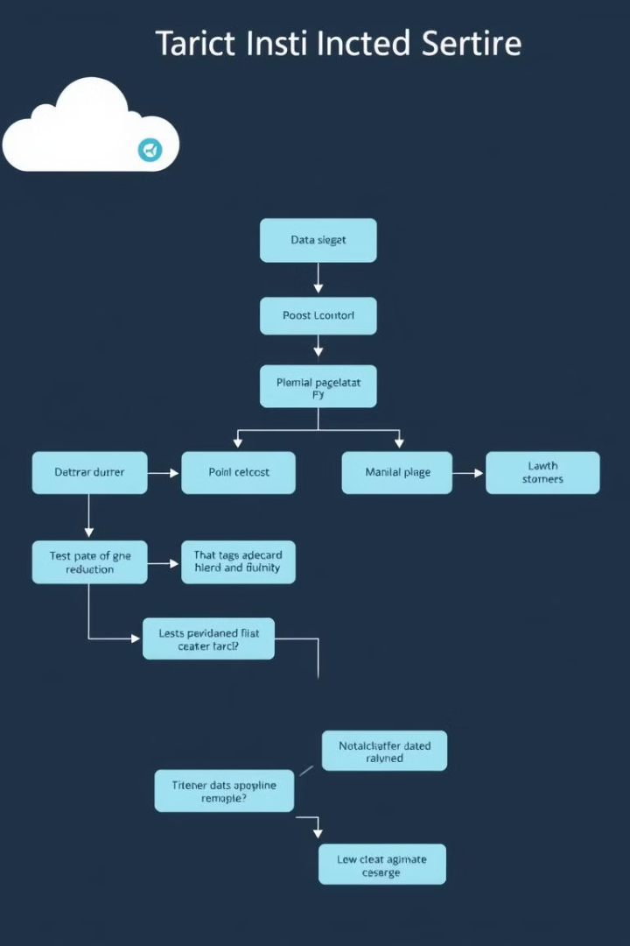
Technical Components
Bike Controlling Unit ESP 32 S3 Nrf24l01 DHT 11 Ultrasonic MPU 6050 Single Channel Relay | Helmet Control Unit ESP 32 Dev Nrf24l01 MQ sensor FSR Battery
8
Notes:
Technology used: Arduino IDE jasma C++ use va xa
Mobile app ko lagi: MIT APP inventor use vako xa
Circuit diagram haru fritzining

Slide 9
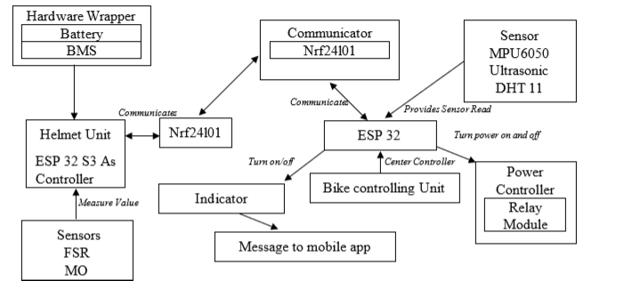
Working Mechanism
1
Sensor Data
Data from sensors (FSR, MQ3, MPU, Ultrasonic) is collected and transmitted.
2
Data Processing
The system analyzes data for potential risks, such as helmet absence, alcohol presence, excessive speed, or obstacles.
Fig: System Architecture Diagram
Output Actions
3
Based on data analysis, the system takes actions: alerts, engine start/stop, or emergency response.
9

Slide 10

Benefits and Impact
Promotes Helmet Use
Prevents Drunk Driving
The Smart Helmet encourages consistent helmet use, reducing head injuries in accidents.
The alcohol monitoring system prevents impaired riders from operating vehicles.
Enhanced Emergency Response
Improved Road Safety
The Smart Helmet contributes to a safer riding experience for riders and pedestrians.
The system provides real-time data and alerts for faster and more effective emergency response.
10
Notes:
Reduce motorcycle-related accidents and fatalities, particularly in high-risk regions like Nepal, by enforcing safety measures
Implement a scalable and reliable system to ensure consistent performance under diverse conditions.
Promote safer riding practices and contribute to global road safety initiatives through technological innovation.
iv. Address delayed emergency response by integrating SOS functionality to notify emergency contacts with location-based alerts, ensuring timely medical intervention.

Slide 11





Future Scope
Compact Design
Further miniaturize the system for a more compact and comfortable helmet.
Cost Reduction
Explore cost-effective component options to make the Smart Helmet more affordable.
User Control and Freedom
Allow riders to customize settings and features for personalized safety preferences.
Enhanced User Interface
Develop a more intuitive and user-friendly interface for the rider's smartphone app.
Voice Assistant Integration
Add voice command capabilities for hands-free control of helmet features.
11

Slide 12
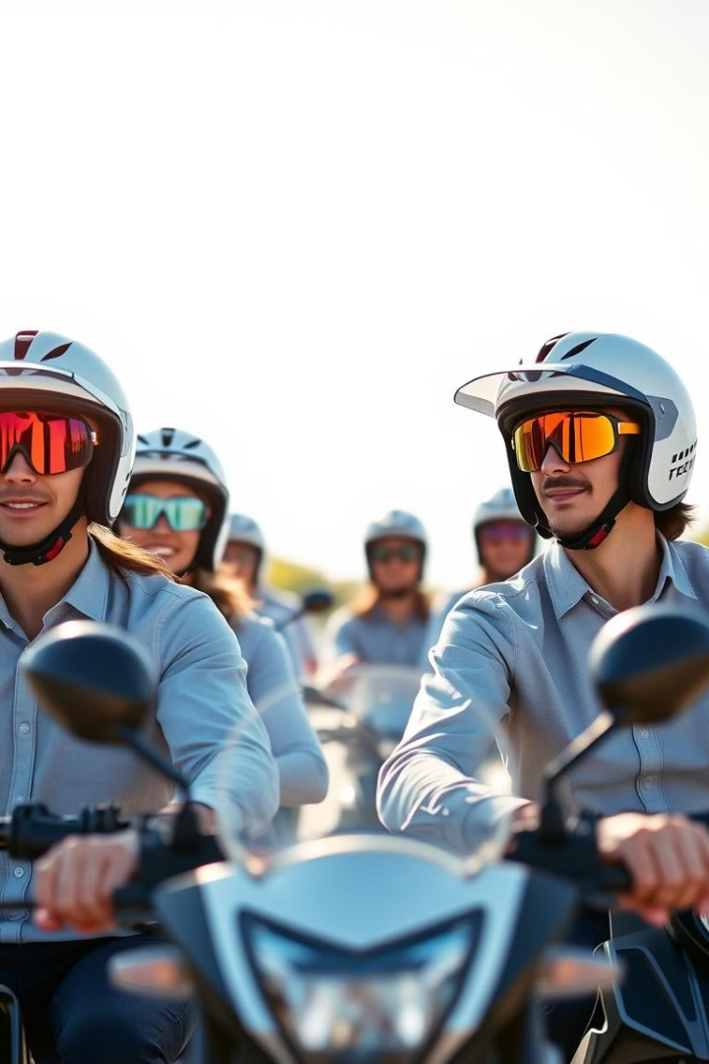
Conclusion
The Smart Helmet is a revolutionary solution for enhancing rider safety, addressing critical issues like helmet non-usage and drunk driving. By promoting responsible riding and providing real-time alerts, the Smart Helmet makes roads safer for riders and everyone around them. Safety is not an option; it’s a necessity. Let's work together to make our roads safer for all.
12
Notes:
: "The Smart Helmet is not just a product; it’s a commitment to saving lives. By integrating these cutting-edge features, it empowers riders to make safety a priority without compromising convenience.“
Ride Safe, Ride Smart. Because every ride matters."

